Slide 1
Georgetown School Committee
School year 2016-2017
Public Meeting
May 17, 2016

Slide 2
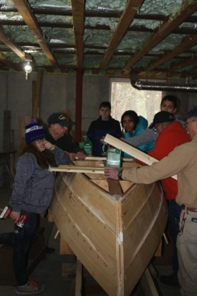
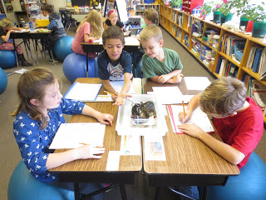
Students engage in authentic learning experiences exploring our unique coastal environment.

Slide 3
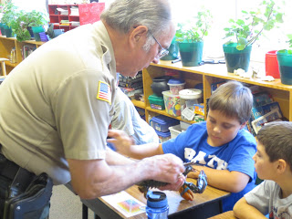

Slide 4
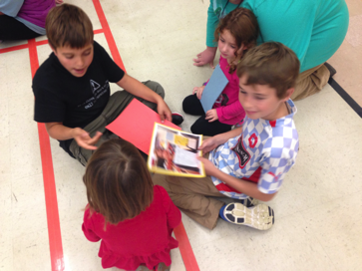
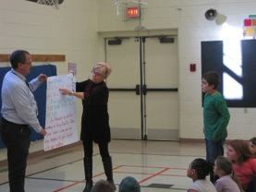
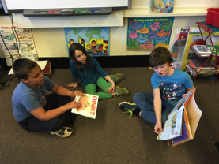
School activities provide our students opportunities to foster and develop relationships throughout the school, reinforcing our positive school community.

Slide 5
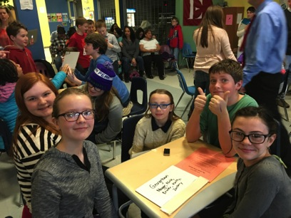
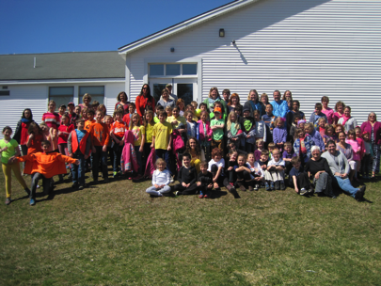
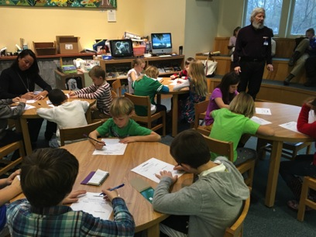

Slide 6
Recommended Expenses
2016-2017 $2,382,506
2015-2016 $2,203,033
Increase of $179,473

Slide 7
Significant Increases Include
Tuition $ 72,759
Special Ed ODP $ 79,740
Special Ed Transportation $ 20,000
Total $172,499

Slide 8
Salary & Benefit Changes

Slide 9
Anticipated Revenues
Tuition $ 25,000
State Subsidy: $ 73,826
15-16 Anticipated Balance $ 75,000
14-15 Excess Carryforward $ 57,000
Total: $ 230,826

Slide 10
Federal Funds
Estimated for FY 17
Title IA Targeted Funds $ 12,010 Title IA Ed Tech
Local Entitlement Special Ed. $ 24,909 Occupational & Physical Therapy
Local Entitlement Pre-School $ 583 used toward Pre-K Supplies
Title IIA Improving Teacher Quality $ 4,754 Conference, Travel & Workshops
REAP Small Schools $ 9,876 STEM Supplies
Total Federal Funds: $ 52,132

Slide 11
Town Assessment
 | School Year 2015-16 |  |  | School Year 2016-17
Expenses |  | $2,203,033 |  |  | $2,382,506
Revenue |  | $-208,202 |  |  | $-230,826
Total |  | $1,994,831 |  |  | $2,151,680
Total Increase of $156,849 or 7.9%

Slide 12
REGULAR INSTRUCTION | 2015-2016 |  | 2016-2017 |  | Increase/Decrease
PK Instruction | 37,163 |  | 40,902 |  | 3,739
K-2 Instruction | 270,878 |  | 264,230 |  | (6,648)
3-6 Instruction Programs | 391,395 |  | 410,721 |  | 19,326
Gifted & Talented | 3,009 |  | 3,140 |  | 131
Grades 7-8 Tuition | 203,149 |  | 162,578 |  | (40,571)
Grade 9-12 Tuition & Ins. Value | 227,168 |  | 340,498 |  | 113,330
Total Regular Instruction | 1,132,762 |  | 1,222,068 |  | 89,306
SPECIAL EDUCATION
Grade 2-6 Tuition | 52,576 |  | 97,576 |  | 45,000
Grades 7-8 Tuition | - |  | - |  | -
Grades 9-12 Tuition | - |  | 4,700 |  | 4,700
All other instruction | 220,625 |  | 244,923 |  | 24,298
Administration | 20,283 |  | 24,437 |  | 4,154
Total Special Education | 293,484 |  | 371,636 |  | 78,152
OTHER INSTRUCTION/SUMMER SCHOOL
Extra Curricular | 6,814 |  | 6,814 |  | (0)
STUDENT/STAFF SUPPORT
Student Support Services:
Guidance Services | 49,809 |  | 52,184 |  | 2,375
Health Services | 9,785 |  | 10,017 |  | 232
Instructional Technology | 63,545 |  | 52,399 |  | (11,146)
Staff Support Services
Improvement of Instruction | 7,000 |  | 5,000 |  | (2,000)
Library Services | 41,845 |  | 43,149 |  | 1,304
Student Assessment | 1,000 |  | 1,000 |  | -
Total Student/Staff Support | 172,984 |  | 163,750 |  | (9,234)
SYSTEM ADMINISTRATION
Superintendent's Office | 59,851 |  | 72,504 |  | 12,653
School Committee | 12,338 |  | 12,338 |  | -
Total System Administration | 72,189 |  | 84,842 |  | 12,653
SCHOOL ADMINISTRATION
Principal's Office | 160,022 |  | 163,659 |  | 3,637
TRANSPORTATION | 147,600 |  | 183,600 |  | 36,000
FACILITIES/PLANT OPERATION/MAINT. | 168,678 |  | 149,637 |  | (19,041)
DEBT SERVICE & OTHER COMMITMENTS
Debt Service Payments | 10,000 |  | 10,000 |  | -
ALL OTHER/SCHOOL LUNCH
School Nutrition Expenditures | 38,500 |  | 26,500 |  | (12,000)
 | 2,203,033 |  | 2,382,506 |  | 179,473

Slide 13
Georgetown Central School Enrollment FY 2015 – FY 2016
13
2015-2016 Actual Enrollment |  |  |  |  | 2016-2017 Projected Enrollment
Grade | Arrowsic | Georgetown | Total |  | Grade | Arrowsic | Georgetown | Total
Pre-K | 0 | 6 | 6 |  | Pre-K | 0 | 6 | 6
K | 0 | 13 | 13 |  | K | 0 | 6 | 6
1 | 0 | 10 | 10 |  | 1 | 0 | 10 | 10
2 | 0 | 9 | 9 |  | 2 | 0 | 10 | 10
3 | 0 | 12 | 12 |  | 3 | 0 | 9 | 9
4 | 1 | 14 | 15 |  | 4 | 0 | 11 | 11
5 | 2 | 7 | 9 |  | 5 | 0 | 14 | 14
6 | 0 | 7 | 7 |  | 6 | 2 | 7 | 9
Total | 3 | 78 | 81 |  | Total | 2 | 73 | 75

Slide 14
14
Georgetown Central Elementary School
Grades 7 - 12 Enrollment
2015-2016 Actual Enrollment |  |  |  |  |  |  |  |  |  |  |  |  |  | 2016-2017 Projected Enrollment
Grade | RSU 1 |  | Bruns |  | MSSM |  | Lincoln |  | NYA |  | CTL | Total |  | Grade | RSU 1 | Bruns |  | MSSM |  | Lincoln | NYA | CTL | Total
7 | 9 |  | 1 |  | 0 |  | 0 |  | 0 |  | 1 | 11 |  | 7 | 7 | 0 |  | 0 |  | 0 | 0 | 0 | 7
8 | 14 |  | 0 |  | 0 |  | 0 |  | 0 |  | 1 | 15 |  | 8 | 9 | 1 |  | 0 |  | 0 | 0 | 1 | 11
9 | 5 |  | 0 |  | 0 |  | 0 |  | 0 |  | 0 | 5 |  | 9 | 15 | 0 |  | 0 |  | 0 | 1 | 0 | 16
10 | 7 |  | 0 |  | 0 |  | 0 |  | 0 |  | 0 | 7 |  | 10 | 5 | 0 |  | 0 |  | 0 | 0 | 0 | 5
11 | 4 |  | 1 |  | 1 |  | 0 |  | 1 |  | 0 | 7 |  | 11 | 8 | 0 |  | 0 |  | 0 | 0 | 0 | 8
12 | 5 |  | 0 |  | 0 |  | 2 |  | 0 |  | 0 | 7 |  | 12 | 3 | 1 |  | 1 |  | 0 | 1 | 0 | 6
Total | 44 |  | 2 |  | 1 |  | 2 |  | 1 |  | 2 | 52 |  | Total | 47 | 2 |  | 1 |  | 0 | 2 | 1 | 53

Slide 15
Budgeted Tuition
 |  | 2015-2016 |  |  | 2016-2017
 |  |  |  |  |  |  | Increase/ (Decrease)
7-8 | 23 students | $203,149 |  | 18 students | $162,578 |  | $(40,571)
9-12 | 22 students + 2 reserve | $227,168 |  | 35 students + 2 reserve | $340,498 |  | $113,330
Total | 47 | $430,317 |  | 55 | $503,076 |  | $72,759

Slide 16
Tuition Cost by School
7-8
RSU 1 $9,023.12 x 16 $ 144,369.92
Center for Teaching & Learning $8,626.01 x 1 $ 8,626.01
Brunswick Jr High School $9,581.71 x 1 $ 9,581.71
Total 18 $ 162,577.64
9-12
RSU 1 $ 8,990.05 x 31 $ 278,691.55
North Yarmouth Academy $ 11,275.80 x 2 $ 22,551.60
Brunswick High School $10,637.55 x 1 $ 10,637.55
ME School of Sci & Math $10,637.55 x 1 $ 10,637.55
Reserve $ 8,990.05 x 2 $ 17,980.10
Total 37 $ 340,498.35

Slide 17
Staffing
Proposed Staff
Principal | Matthew Carlson | 1 FTE | $86,714.00
Four-year old program | Mindy Kebles | .5 FTE | $19,800.00
Kindergarten Teacher | Laurie Martin | 1 FTE | $53,692.00
First Grade | Beth Saufler | 1 FTE | $71,816.00
Second Grade | Susan Morissette | 1 FTE | $70,617.00
Third Grade | Marcie Look | 1 FTE | $58,117.00
Fourth Grade | Susan Ayers | 1 FTE | $70,617.00
Fifth Grade | Cindy Irving | 1 FTE | $68,600.00
Sixth Grade | Sarah Guethle | 1 FTE | $38,692.00
Special Education | Pam Farnsworth | 1 FTE | $70,617.00
Library/Tech Integrator | Megan Fuller | 1 FTE | $52,117.00
Music | Jill Palmer | .4 FTE | $22,440.00
Art | Karen Wolfe | .4 FTE | $27,440.00
P.E. | Peter McDaniel | .2 FTE | $9,420.00
Guidance | Debra Thibodeau | .8 FTE | $48,652.80

Slide 18
Support Staff
Proposed
Secretary | Leslie McMahan | 1 full time | $31,899.56
Custodian | Mark Donovan | 1 full time | $39,520.00
Custodian | David Knauber | 1 half time | $16,235.18
Nurse | Stephanie Pruzansky | 1 day / week | $9,298.80
Ed Tech | Karen Hasenfus-Barabe | 1 full time | $19,918.02
Ed Tech | Kathy Cecero | 1 full time* | $20,466.06
Cook | Nancy Cressey | 1 full time | $24,086.24
 | * .5 of this position paid by another district

Slide 19
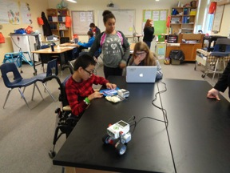
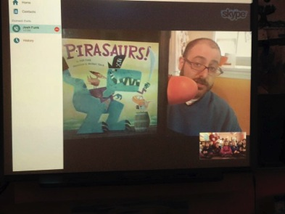
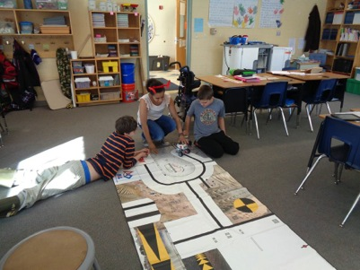
Integrating technology engages our students and teaches problem solving and critical thinking skills necessary for 21st century learning. Technology allows for making global connections for students to learn through others.

Slide 20
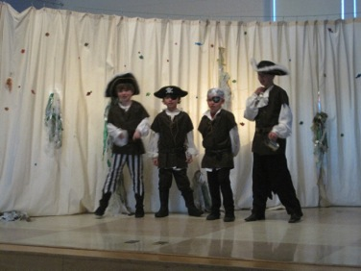
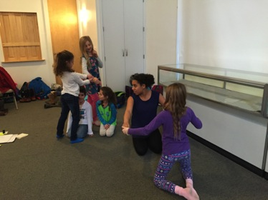
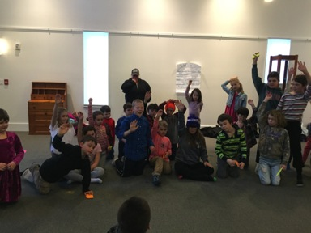
Students benefit from fine arts instruction and extracurricular opportunities.

Slide 21
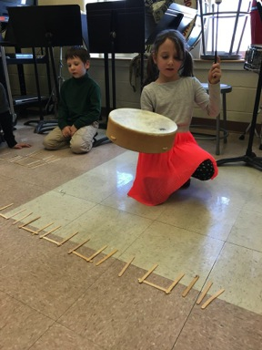
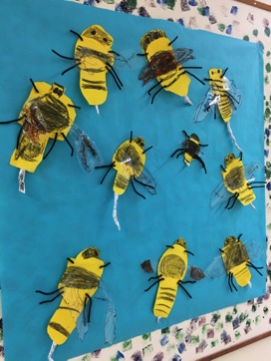
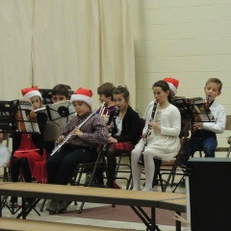
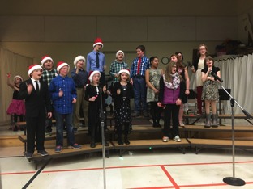
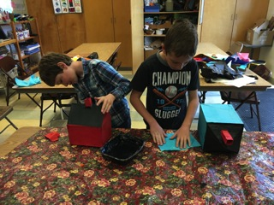

Slide 22
Budget presentation
Please come to town meeting to vote.
Upcoming meetings:
Elections – June 14th
Town Meeting – June 18th

